Slide 1
COVID-19’s Impact on US Stock Market
Muhammad Usama Ijaz Nikola Danevski
Notes:
Hello. Today we will talk about the impact of COVID-19 on the US Stock Market. This project was done in collaboration of Muhammad Usama Ijaz and Nikola Danevski.

Slide 2

Introduction and Problem Statement
Methodology
Discussion & Conclusion
Notes:
The structure of the presentation is as follows: We will first talk about introduction and problem statement, followed by our methodology and solution approach. In the end, we discuss and form a conclusion on our research.

Slide 3


Introduction and Motivation
The stock market has fluctuated due to growing concerns of COVID-19. “Since the outbreak, stocks have definitely fallen more than 20% from its peak,” says Edward Jones financial Advisor, Theresa Hayes. “Stocks were at record highs less than one month ago.”
Factors of Impact Is there a common attribute among the companies with same range of impact?
Concentrated Funding What factors should the government consider before funding any group of companies?
We hypothesize that funding companies by sectors might be the best approach.
Notes:
COVID-19 is a virus that originated in late 2019 in China, and at the time of writing of this paper there are more than 3.8 million cases globally. Through drastic measures, China managed to reduce the number of new daily cases from its peak at 14,000 cases on February 12, 2020, to only 11 cases per day one month later. However,the virus rapidly spread through the rest of the world, heavily hitting western Europe and the United States of America. With the fear of the virus spreading throughout USA, the US stock exchange has been heavily impacted. The Dow Jones, one of the most popular stock market indices, hit its lowest point in more than a year on March 12, 2020. The stock market has fluctuated due to growing concerns of COVID-19. “Since the outbreak, stocks have definitely fallen more than 20% from its peak,” says Edward Jones financial Advisor, Theresa Hayes. “Stocks were at record highs less than one month ago.”

Slide 4
Problem Statement
Understanding the importance of attributes of companies for predicting the impact of COVID-19 on its stock price
Is there a common attribute among the companies with same range of impact?
How?
Classification Algorithms
Notes:
Our problem statement can be summarized as follows:
“Understanding the importance of attributes of companies for predicting the impact of COVID-19 on its stock price”.
We use stock-market high prices for each day in a 5-month period and apply data mining methods to better understand the impact of COVID-19 on the S&P 500 companies. Understanding which attributes are important is a well-known problem that has been studied, however we argue that it is harder to use any of those statistical methods with continuous data. That is why we apply classification methods to understand which attributes of a certain company affect its stock market price increase or decrease the most. The attributes we get in the end are the ones that the Federal Reserve should be looking at when deciding how and where to inject the money.

Slide 5
Introduction and Problem Statement
Methodology
Evaluation
Notes:
Now we will proceed with the methodology of our research project.

Slide 6
Methodology
Data Collection
Attribute Selection Measures
Classification Algorithms
Notes:
Our research contains three parts; Data Collection and its preprocessing, looking at previous attribute selection measures and applying Classification Algorithms to it.

Slide 7
Methodology
Data Collection
Attribute Selection
Calculating Average Price
Data Cleaning
Attribute Selection Measures
Classification Algorithms
Notes:
In order to collect our data, we had to make a choice about our attributes, calculate the average stock price before and after the coronavirus outbreak and then clean the data.
We collected information for the S&P top 500 companies from Yahoo Finance. Since we wanted to see the effect of COVID-19 on the stock market, we considered stock prices before the COVID-19 outbreak, and during. This period ranges from 11-15-2019 to 04-20-2020.

Slide 8
Methodology
Data Collection
Attribute Selection
Calculating Average Price
Data Cleaning
Attribute Selection Measures
Classification Algorithms
Notes:
We will firstly cover attribute selection. The Yahoo Finance website provides one with a number of attributes for a company. Many of these are unique and thus not helpful in classification. The attributes we decided to work with are shown on the next slide.

Slide 9
Attribute Selection
Sector: a categorical variable across 11 different sectors
Full Time Employees: a continuous variable
Enterprise Value: a continuous variable
Profit Margins: a continuous variable
Market Cap: a continuous variable
Ask Size: a continuous variable
Average Increase/Decrease in price (in %): an ordinal variable
Notes:
Our attributes include the following: Sector, a categorical variable across 11 different sectors. Then we have Full Time Employees, Enterprise Value, Profit Margins, Market Cap and Ask Size which are all continuous data about companies. Average Increase/Decrease of a company’s price is an ordinal variable explained in the next slide.

Slide 10
Methodology
Data Collection
Attribute Selection
Calculating Average Price
Data Cleaning
Attribute Selection Measures
Classification Algorithms
Notes:
As one of our main attributes, we calculate the average of the High stock price before and after the coronavirus outbreak. Then we calculate the increase or decrease the company has had and represent it in percentage.

Slide 11
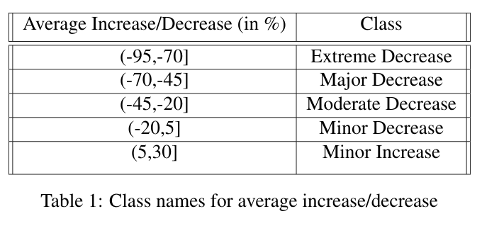
Average Increase/Decrease
Notes:
Since we wanted to apply classification algorithms on the price, we converted it into an ordinal variable as shown in the table using binning method with equal width.

Slide 12
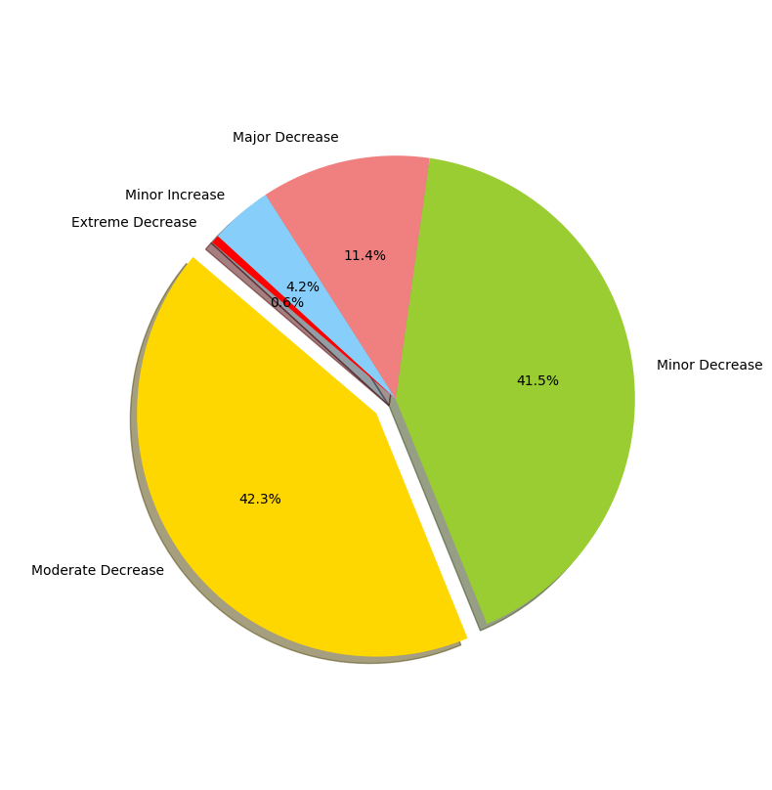
Average Increase/Decrease
Notes:
This pie chart shows our that for this attribute we have an imbalanced representation of the data points.

Slide 13
Methodology
Data Collection
Attribute Selection
Calculating Average Price
Data Cleaning
Attribute Selection Measures
Classification Algorithms
Notes:
Financial data is usually very clean, however we had to do some preprocessing. We removed companies for which we could not access the prices and for which the majority of the attributes we were looking for were notpresent in the Yahoo Finance Database.

Slide 14
Methodology
Data Collection
Attribute Selection
Calculating Average Price
Data Cleaning
Attribute Selection Measures
Classification Algorithms
Notes:
Next we proceed with covering attribute selection measures and explaining why they wouldn’t work properly for our purpose.

Slide 15
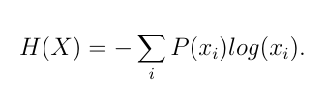
Attribute Selection Measures
work done in categorical data
continuous data requires binning
not efficient (enough)
Entropy:
Notes:
We have a few attributes with continuous variables. However, the current work measuring attribute selection uses categorical data. If we decided to use binning by frequency, we would see that entropy for every class of the attribute will be equal according to equation on the right. This is bad because every attribute selection measure depends on entropy. On the other hand, if we chose to do some other form of binning, we would have a very big complexity and not a good approximation. That is why decide on the importance of the attributes via classification.

Slide 16
Methodology
Data Collection
Attribute Selection Measures
Classification Algorithms
Bayesian network Classifier
Random Forest Classifier
LogitBoost Classifier
Multi-Layer Neural Network
Notes:
Next, we will talk about applying classification algorithms to our dataset. We decided on using 4 different classification algorithms as shown in the slides to extract knowledge about our dataset and form a conclusion for our problem statement. We use 10-fold cross validation in order to train and test the data for each of the classifiers.

Slide 17
Methodology
Data Collection
Attribute Selection Measures
Classification Algorithms
Bayesian network Classifier
Random Forest Classifier
LogitBoost Classifier
Multi-Layer Neural Network
Notes:
We will first talk about the Bayesian network Classifier.

Slide 18
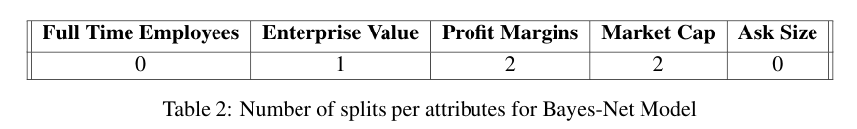
Bayesian network Classifier
Accuracy: 64.06%
Sector is important
For continuous variables, choose splits.
Some attributes are more important than others.
Notes:
It is based on probability. The classifier considers each sector separately in its probability table. However, for our continuous attributes it works differently. It chooses the best splits (if any) from which it can gain knowledge the most. The accuracy we got for this model is 64.06%. The number of splits is shown in the table, and this gives us information about the knowledge our model can extract from its data. As a conclusion, we can see that Full Time Employees is not as good of an attribute as Market Cap if we used probability based classifiers because the model doesn’t split the data in any way.

Slide 19
Methodology
Data Collection
Attribute Selection Measures
Classification Algorithms
Bayesian network Classifier
Random Forest Classifier
LogitBoost Classifier
Multi-Layer Neural Network
Notes:
Next we will cover the Random Forest Classifier.

Slide 20
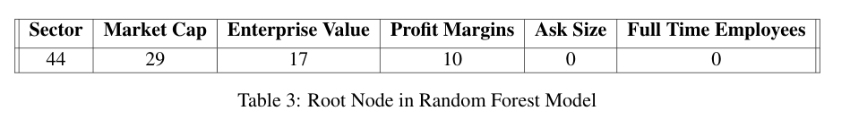
Random Forest Classifier
Accuracy: 65.46%
More robust to errors and outliers
Chooses the best separation attribute from a random set
Sector and Market Cap dominate as root node attributes.
Notes:
Random Forest Classifier creates a number of trees (100 in our case) and chooses the best attribute from a random sample to split the data on each time accordingly. Its accuracy was around 65% and we noticed that it handled outlier points better than the rest. After analyzing the root node of each of the trees, we noticed that Sector and Market Cap were dominating as the choice made by Random Forest, while Ask Size or Full Time Employees were not chosen even once.

Slide 21
Methodology
Data Collection
Attribute Selection Measures
Classification Algorithms
Bayesian network Classifier
Random Forest Classifier
LogitBoost Classifier
Multi-Layer Neural Network
Notes:
Next we will cover the LogitBoost Classifier that is an upgraded version of AdaBoost.

Slide 22
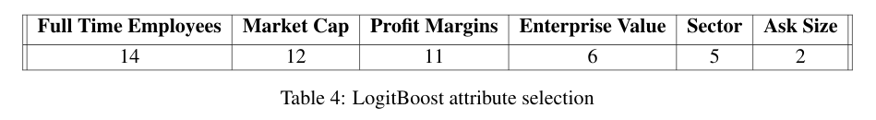
LogitBoost Classifier
Accuracy: 66.02%
Uses decision stump to assign weights
Frequency of attributes chosen as roots for each class.
Notes:
LogitBoost results with an accuracy of 66.02%, the highest we get in our algorithms. In order to classify a data point, LogitBoost uses decision stumps (one-level decision trees) of the attributes. We look at the frequency of each attribute as a decision stump root. We noticed that LogitBoost looks at the attributes with frequency as shown in the table. One can see that full time employees is considered the most, contrary to what we’ve seen so far. We will discuss this in the evaluation part of our presentation.

Slide 23
Methodology
Data Collection
Attribute Selection Measures
Classification Algorithms
Bayesian network Classifier
Random Forest Classifier
LogitBoost Classifier
Multi-Layer Neural Network
Notes:
As a last classifier, we decided to train a multi-layer neural network.

Slide 24
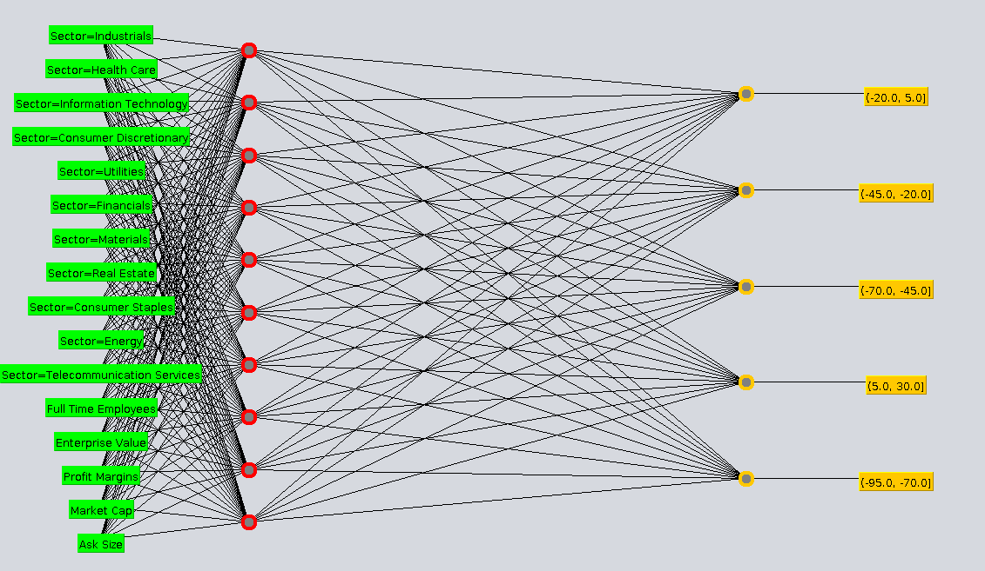
Multi-Layer Neural Network
Accuracy: 61.28%
Black box
Not perfect model for our problem.
Notes:
This classifier returned an accuracy of 61.28%. Even though the accuracy was not bad, we decided that a multi-layer neural network is not very useful for our problem of comparing attributes and their importance. Since neural networks act as black boxes, we can't understand what the layers fully represent, rather give an educated guess. However, we decided not to continue further with this approach.

Slide 25
Introduction and Problem Statement
Methodology
Discussion & Conclusion
Notes:
Now we will move on the discussion and conclusion of our research.

Slide 26
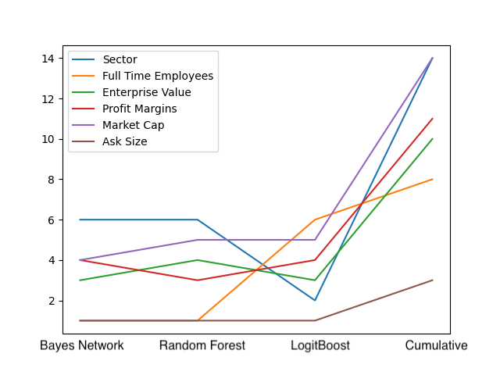
Discussion
Assigned ranks based on the results from classifiers.
Clearly Sector, Market Cap, and Profit are the most influential.
Notes:
Previously we defined number of splits per attribute in Bayesian-Network, root nodes in Random Forest, and frequency of each attribute as a decision stump root in LogitBoost. We combine this information to assign a rank from 1 to 6 to each attribute according to how important that classifier considered it. In the end we find the cumulative rank of each attribute, summarized in the Figure.
We can see that, and outperform the other attributes. Thus, if we need to choose attributes, these are the most important and descriptive ones about our data set.

Slide 27
Conclusion
Proportionalized funding based on the impact
Take early action by predicting the impact on a stock based on their Sector, Profit Margins, and Market Cap
Notes:
We measure the impact in percentage increase/decrease in stock price after the outbreak of COVID-19. This is an important finding as it provides the government with a metric at the impact level. The classification models provide a prediction on the impact of COVID-19 on the stock price, given its sector, profit margins and market cap . It can be utilized to design policies and allocate funds in a proportion corresponding to the impact level of the stock. This can potentially help stabilize the economy by efficient injection of funds into the stock market.

Slide 28
Acknowledgments
Thanks to Prof. Jiebo Luo and Muhammad Ahmad.
Notes:
Thanks to Prof. Jiebo Luo and Muhammad Ahmad.

Slide 29
References
Marketplace - market reactions to COVID-19: Stocks end the week in decline. 2020.
Politico - fed announces massive cash injection to relieve u.s. debt market. 2020.
Wikipedia - multilayer perceptron. 2020.
Yahoo finance - stock market live, quotes, business amp; finance news. 2020.
Scott R Baker, Nicholas Bloom, Steven J Davis, Kyle J Kost, Marco C Sammon, and Tasaneeya Viratyosin.The unprecedented stock market impact of COVID-19. Working Paper 26945, National Bureau of Economic Research, April 2020.
Jerome Friedman, Trevor Hastie, and Robert Tibshirani. Additive logistic regression: a statistical view of boosting (with discussion and a rejoinder by the authors).Ann. Statist., 28(2):337–407, 04 2000.
Stefano Giglio, Matteo Maggiori, Johannes Stroebel, and Stephen Utkus. Inside the mind of a stock market crash. 2020.
Jiawei Han, Micheline Kamber, and Jian Pei. 8 - classification: Basic concepts. In Jiawei Han, Micheline Kamber, and Jian Pei, editors,Data Mining (Third Edition), The Morgan Kaufmann Series in Data Management Systems, pages 327 – 391. Morgan Kaufmann, Boston, third edition edition, 2012.
Bohdan M. Pavlyshenko. Regression approach for modeling COVID-19 spread and its impact on stock market. 2020.
Pier Francesco Procacci, Carolyn E. Phelan, and Tomaso Aste. Market structure dynamics during COVID-19 outbreak. 2020.
Stuart Russell and Peter Norvig. Artificial intelligence - a modern approach. 20100.
Fabian Stephany, Niklas Stoehr, Philipp Darius, Leonie Neuhäuser, Ole Teutloff, and Fabian Braesemann.The corisk-index: A data-mining approach to identify industry-specific risk assessments related to COVID-19in real-time. 2020.
Heather Yan, Andy Tu, Logan Stuart, and Qingquan Zhang. Analysis of the effect of COVID-19 on the stock market and potential investing strategies. 2020
Notes:
Here are our references.

